Slide 1
Empathetic Conversational Model
Presented to Dr.Arya
Team 17
Sara Motamed | Noha Fahim
300389899 | 300389909
Nasser Mohamed | Alaa Rabie
300389893 | 300389374

Slide 2
01
Problem Formulation
02
Data Exploration
03
Feature Engineering
Table of Content
04
Classification
05
Clustering
06
Deployment
07
Error Analysis

Slide 3
Problem Formulation
There are challenges in Natural Language Understanding regarding Arabic language, and this is due to the lack of appropriate datasets available for training. So, our goal for this project is to develop an empathetic Arabic conversational chatbot.

Slide 4
Data Preparation

Slide 5
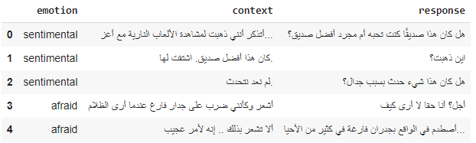
Snippet of Data

Slide 6
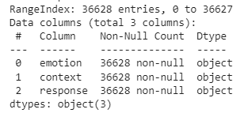
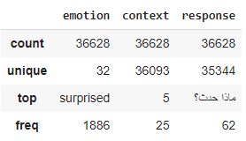
Snippet of Data

Slide 7
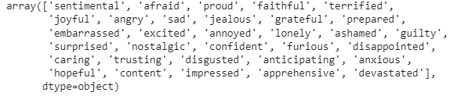
Emotions in the Data

Slide 8

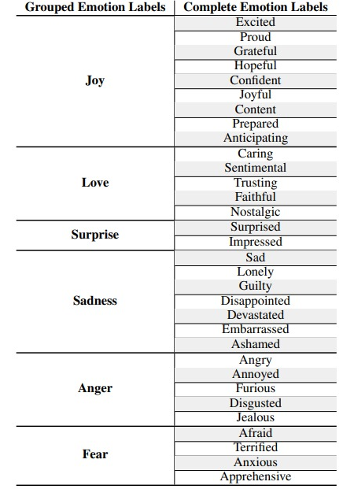
Grouping of Emotions

Slide 9
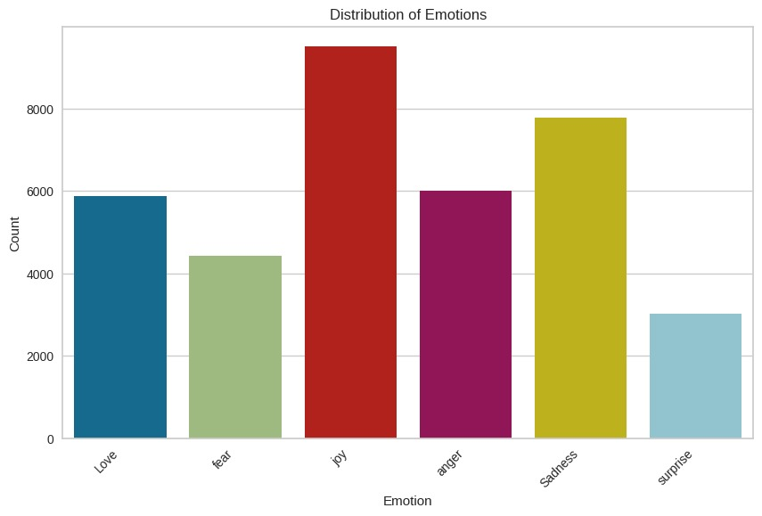
Visualization of Emotions

Slide 10
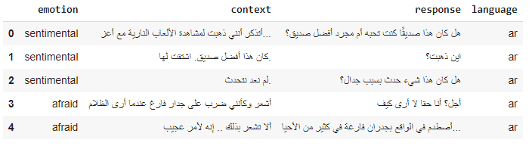
Filter out Non-Arabic

Slide 11
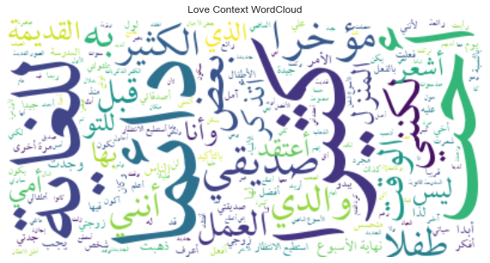
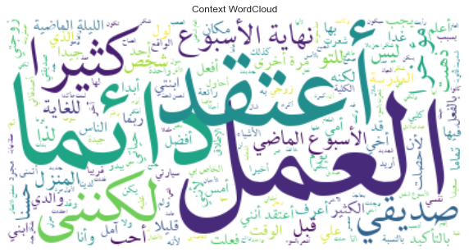
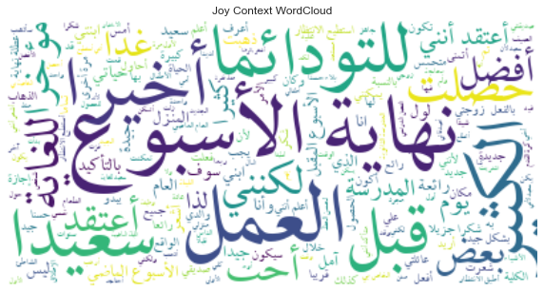
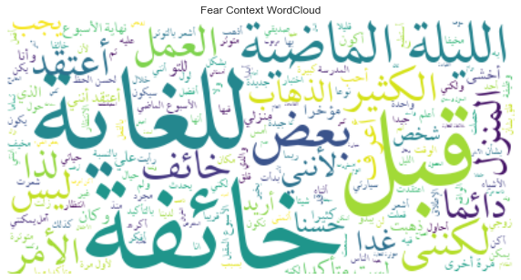
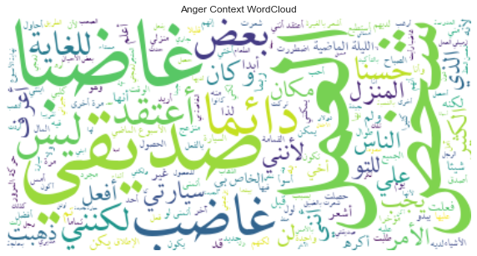
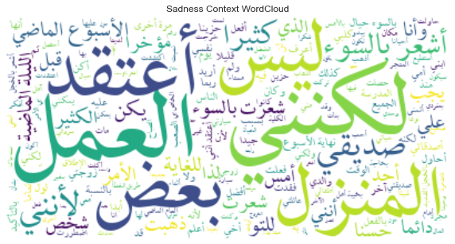
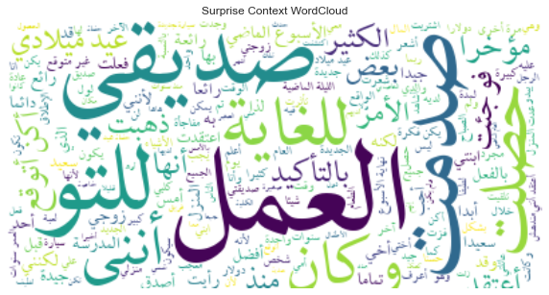
WordCloud
Notes:
-standardize text (tashkeel)
-Normalize Arabic text to standard form
-Remove non-Arabic characters, numbers, and extra spaces
-Remove Stopwords

Slide 12
Feature Engineering

Slide 13
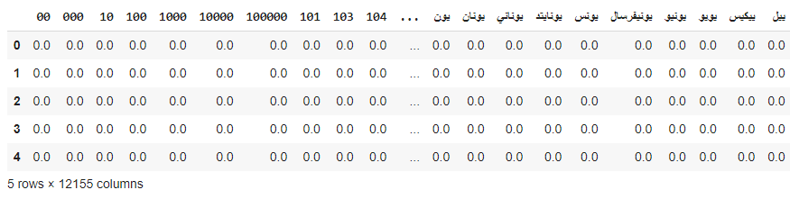
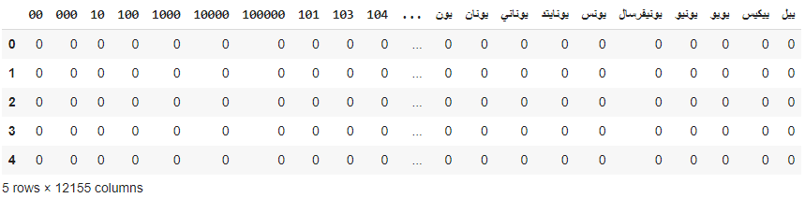
Data Transformation
TFIDF
BoW

Slide 14
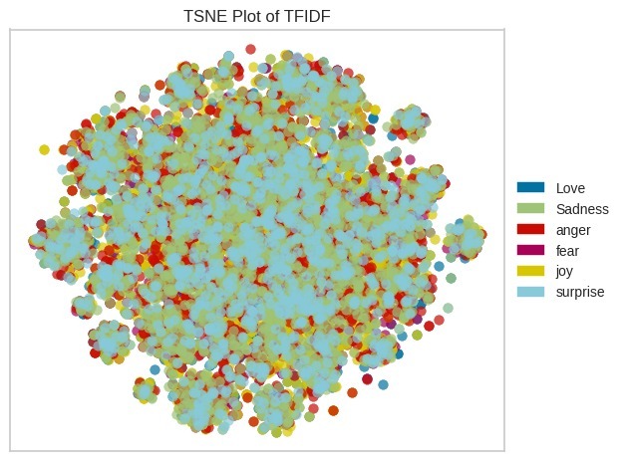
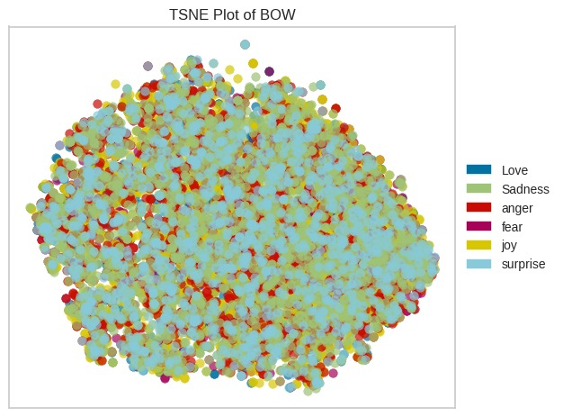
t-SNE Visualization

Slide 15
Classification

Slide 16
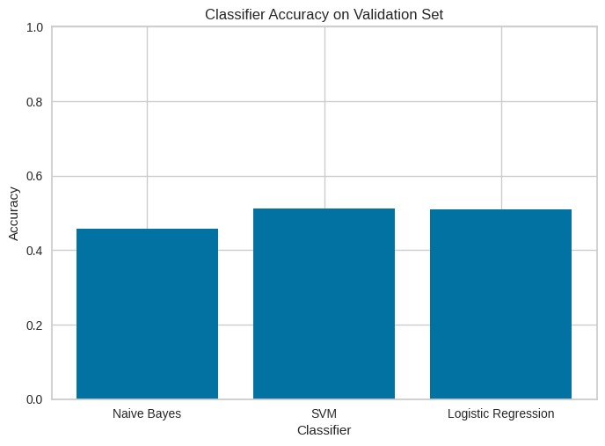
Classification Results

Slide 17
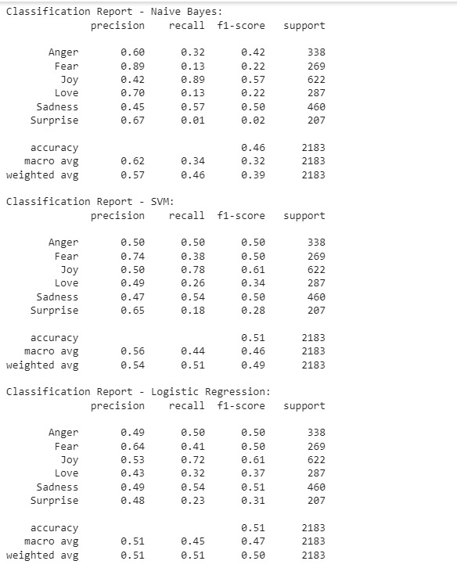
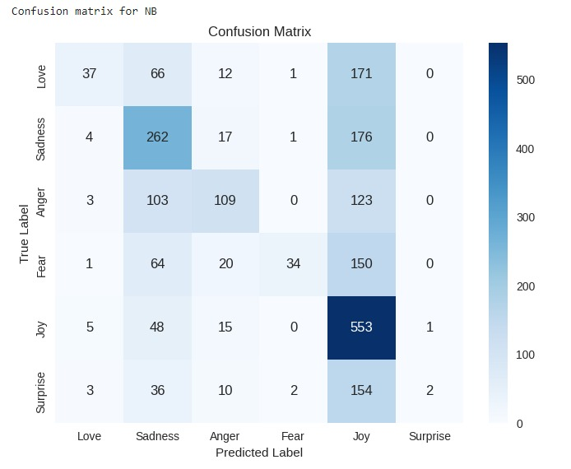
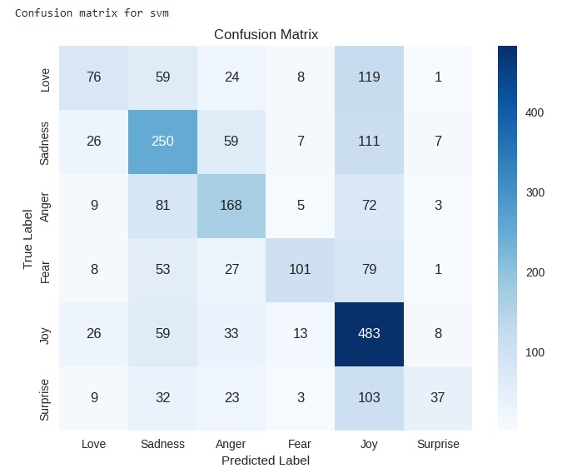
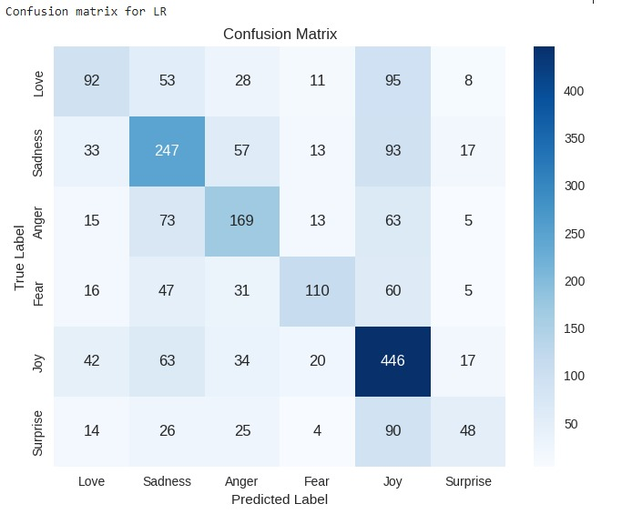
Classification results Cont’d

Slide 18
Clustering

Slide 19
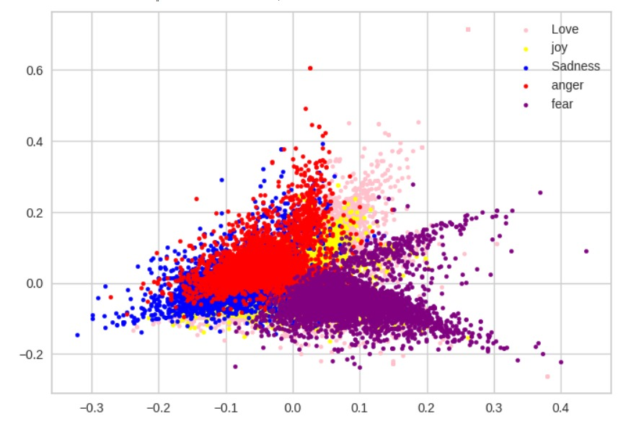
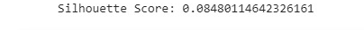
K-means Visualization

Slide 20
Deployment

Slide 21
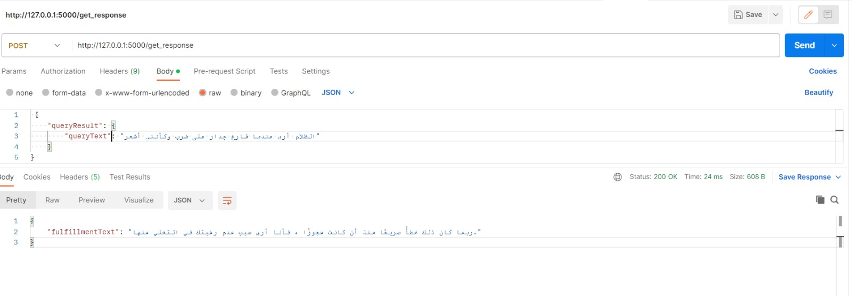
Testing on Postman

Slide 22
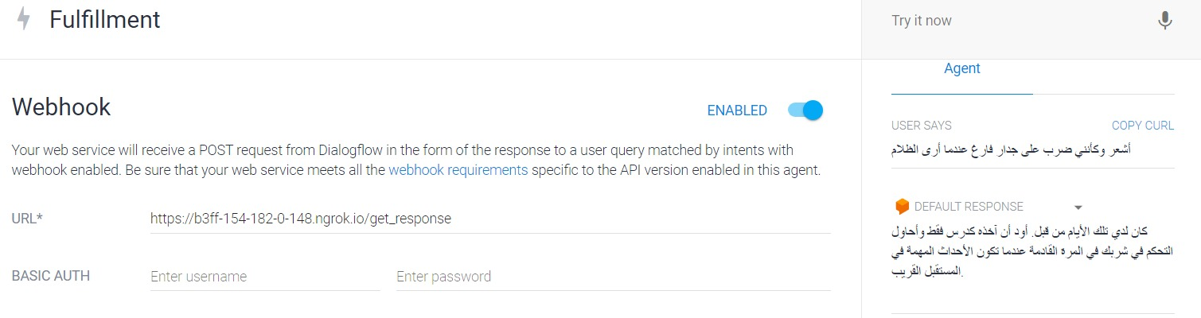
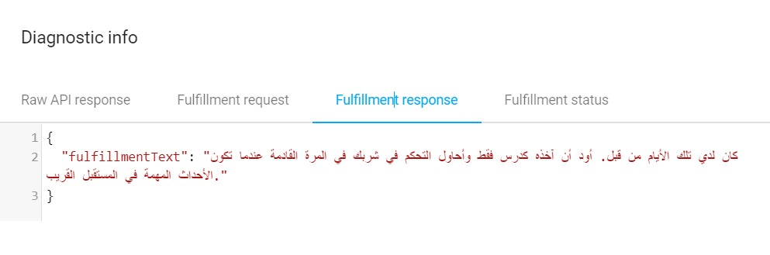
Deployment on DialogFlow

Slide 23
Evaluation

Slide 24
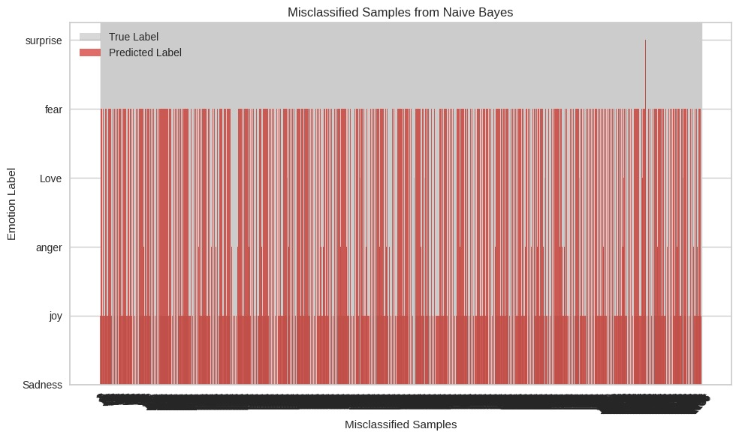
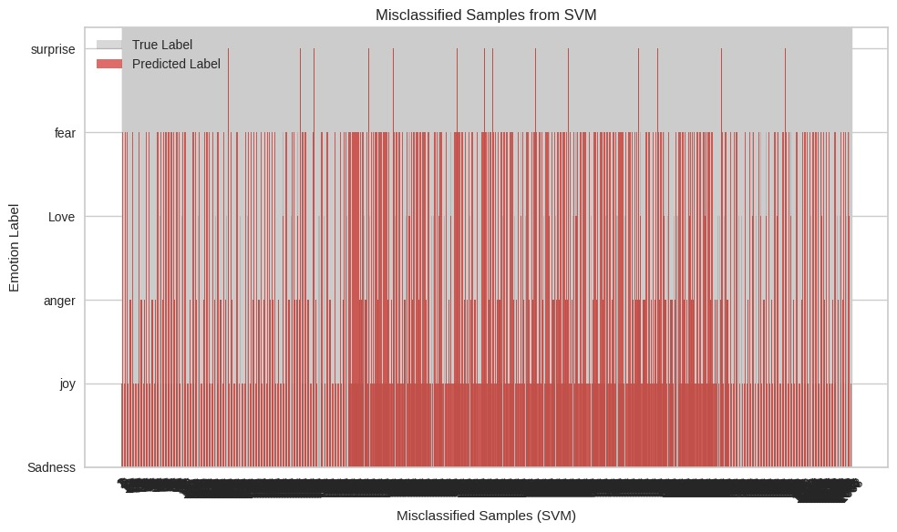
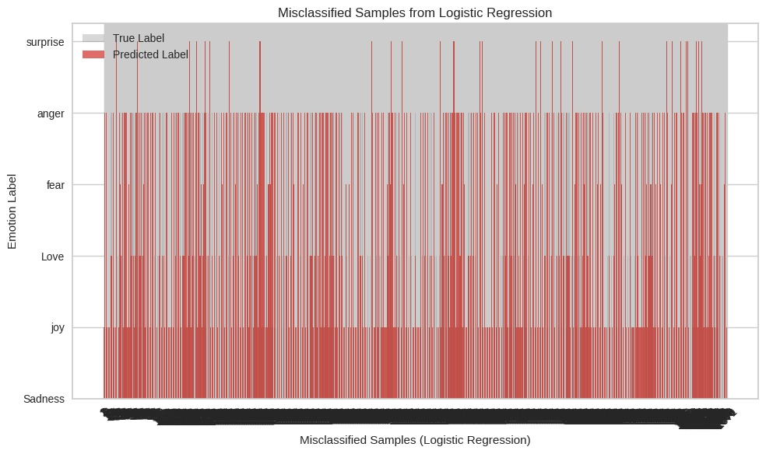
Models Evaluation

Slide 25
Thank You
Any Questions?

